Slide 2

Team Sorted 1. Mohit Kiradoo 2. Devesh Sinha 3. Kajal Gupta

Slide 3





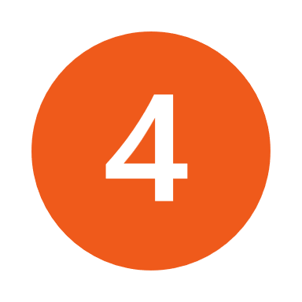






Executive Summary | Round 1 Recap
Untapped customer base from Tier 2+ cities, despite 66% of the demand on Flipkart from these locations. A comprehensive analysis is required to engage the existing customers on the platform and onboard new shoppers who are online but not on ecommerce breaking their trust barriers
C1: Tier 3+
Current tier 2+ focused eatures
Values
Financial Mindset
Technical Orientation
Shopping Mindset
Video Commerce feature in 2022
Shopsy social commerce in 2021
- High resistance to change
- sporadic internet access
- Family centric specially kids
- Cash heavy (below INR 500)
- Conservative saving mechanism
- High dependence on credits
- Mobile usage for calling WhatsApp, limited bandwidth usage
- Price sensitive shopping
- Place: Wholesale, Bazar, trustworthy person
Personalised UI Based on language
C1: Tier 3+
Gaming feature launched in 2020
Flipkart Supercoins launched in 2019
Flipkart BNPL launched in 2019
- Mod. resistance to change
- Continuous internet access
- Seek social approval
- Cash heavy (INR 500-1000)
- Conservative saving mechanism
- Moderate dependence on credits
- Mobile usage for calling,
texting, social
networking, entertainment
- Shopping is image, loyalty
driven
- Place: Personal relation, mall
C2: Tier 3
acts
96.2 Mn¹ users in tier 2 and beyond
- Low resistance to change
- Continuous internet access
- Both family and Self centric
- Cash and card (INR 500-1000)
- Contemporary saving mechanism
- Low/ No dependence on credits
- High mobile usage
- Internet is their lifeline
- App savvy
- Shopping is value driven
- Place: Wholesale, retail,
malls, online
50% up in tier 2+ via Reach Project²
C3: Tier 2
New App design for tier 2+ in 2022³
Opportunities: KPMG Survey¹¹ on spending habits, digital payments and Ecommerce. 2376 respondents (63% from Tier 2 and Tier 3). Timeline: 2020 to June 2020
Primary Research
Consumer insights and pain points
Tier 2 cities
Value proposition: ease of shopping, convenience, rewards & fast delivery
Purchase parameters: product quality, return policy, availability
Pain points: Deals & offers are not communicated, product reviews are not trustworthy
Tier 3+ cities
Value proposition: family or group shopping with experience
Purchase parameters: platform trust, price, credit
Pain points: Fears to get cheated online, unaware about social commerce, fears online payment
Tier 3 cities
Value proposition: ability to purchase at a lower price point
Purchase parameters: price, credit
Pain points: Cognitive overload, touch and feel, high platform switching
128 responses
13 Interviews
Tier-3 is found 1.9X more optimistic on their spending habits than Tier-1
Udupi, Bikaner, Agra
Tier - 2&3 cities are more inclined towards online buying mode almost 2X than Pre – COVID-19.
Idea #1
Idea #2
Idea #3
Virtual Trial Room: The idea is to engage the existing flipkart users of Tier 2,3 & 3+ towns replicating the offline buying experience on the platform.
Pooled buying: The idea is to acquire TG in Tier 2 and 2+: Who shops in groups with friends and family pooling to avail heavy discounts on their purchase.
Shopsy Reseller Activation: The idea is to acquire TG in Tier 3 and 3+ through indirect onboarding and direct selling by incentivizing and educating resellers.
Tier-3 cities are 1.4X more inclined towards spending on Apparel than Tier-1 cities for spending more than INR5000.

Slide 4
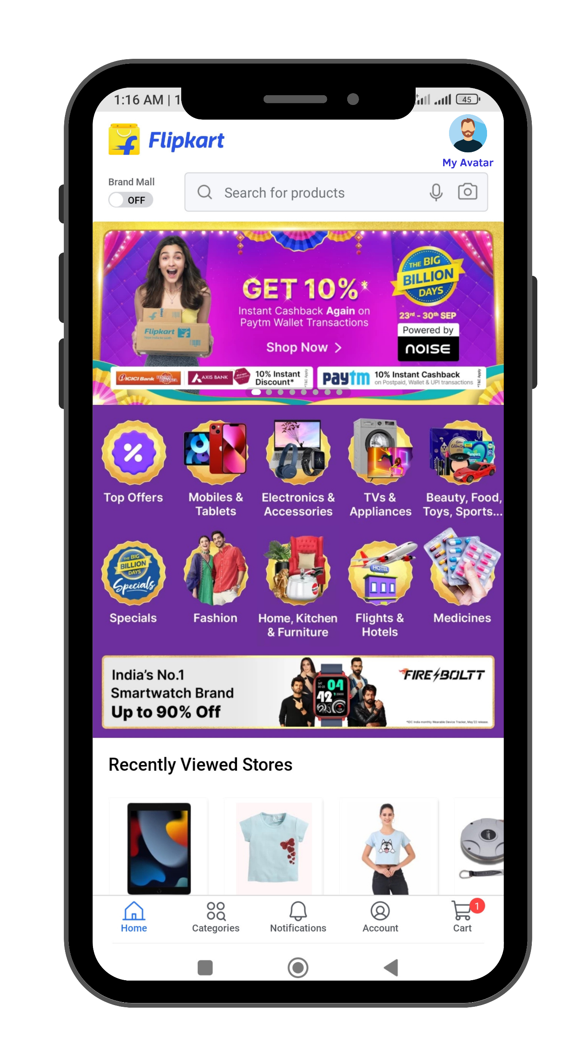
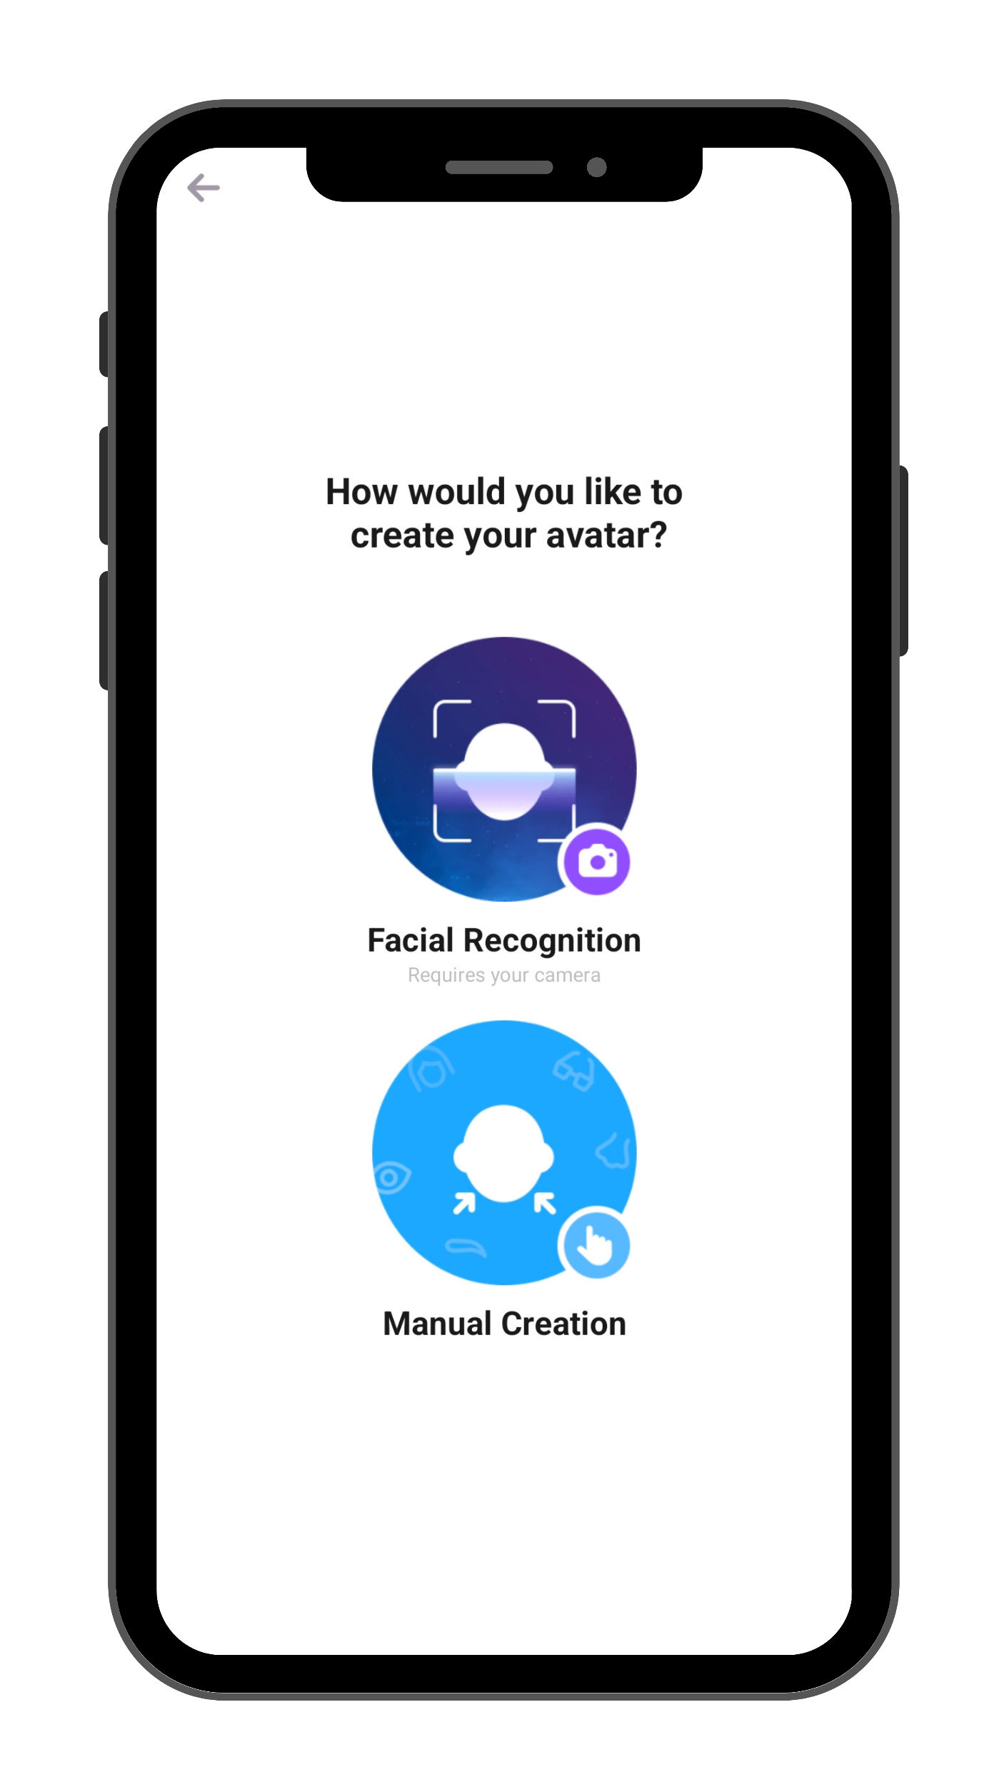
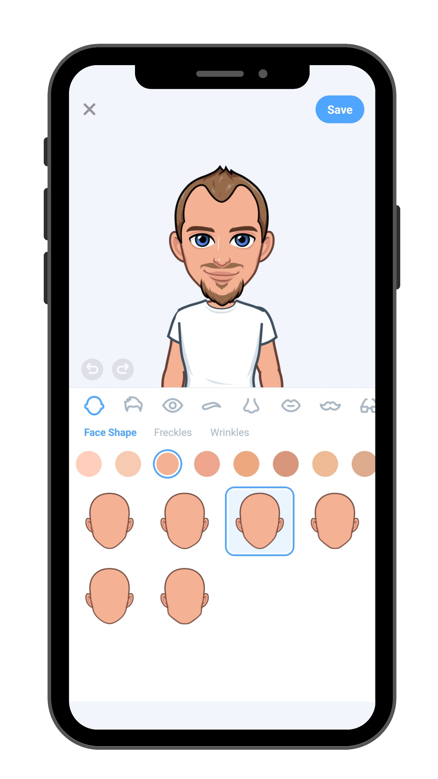
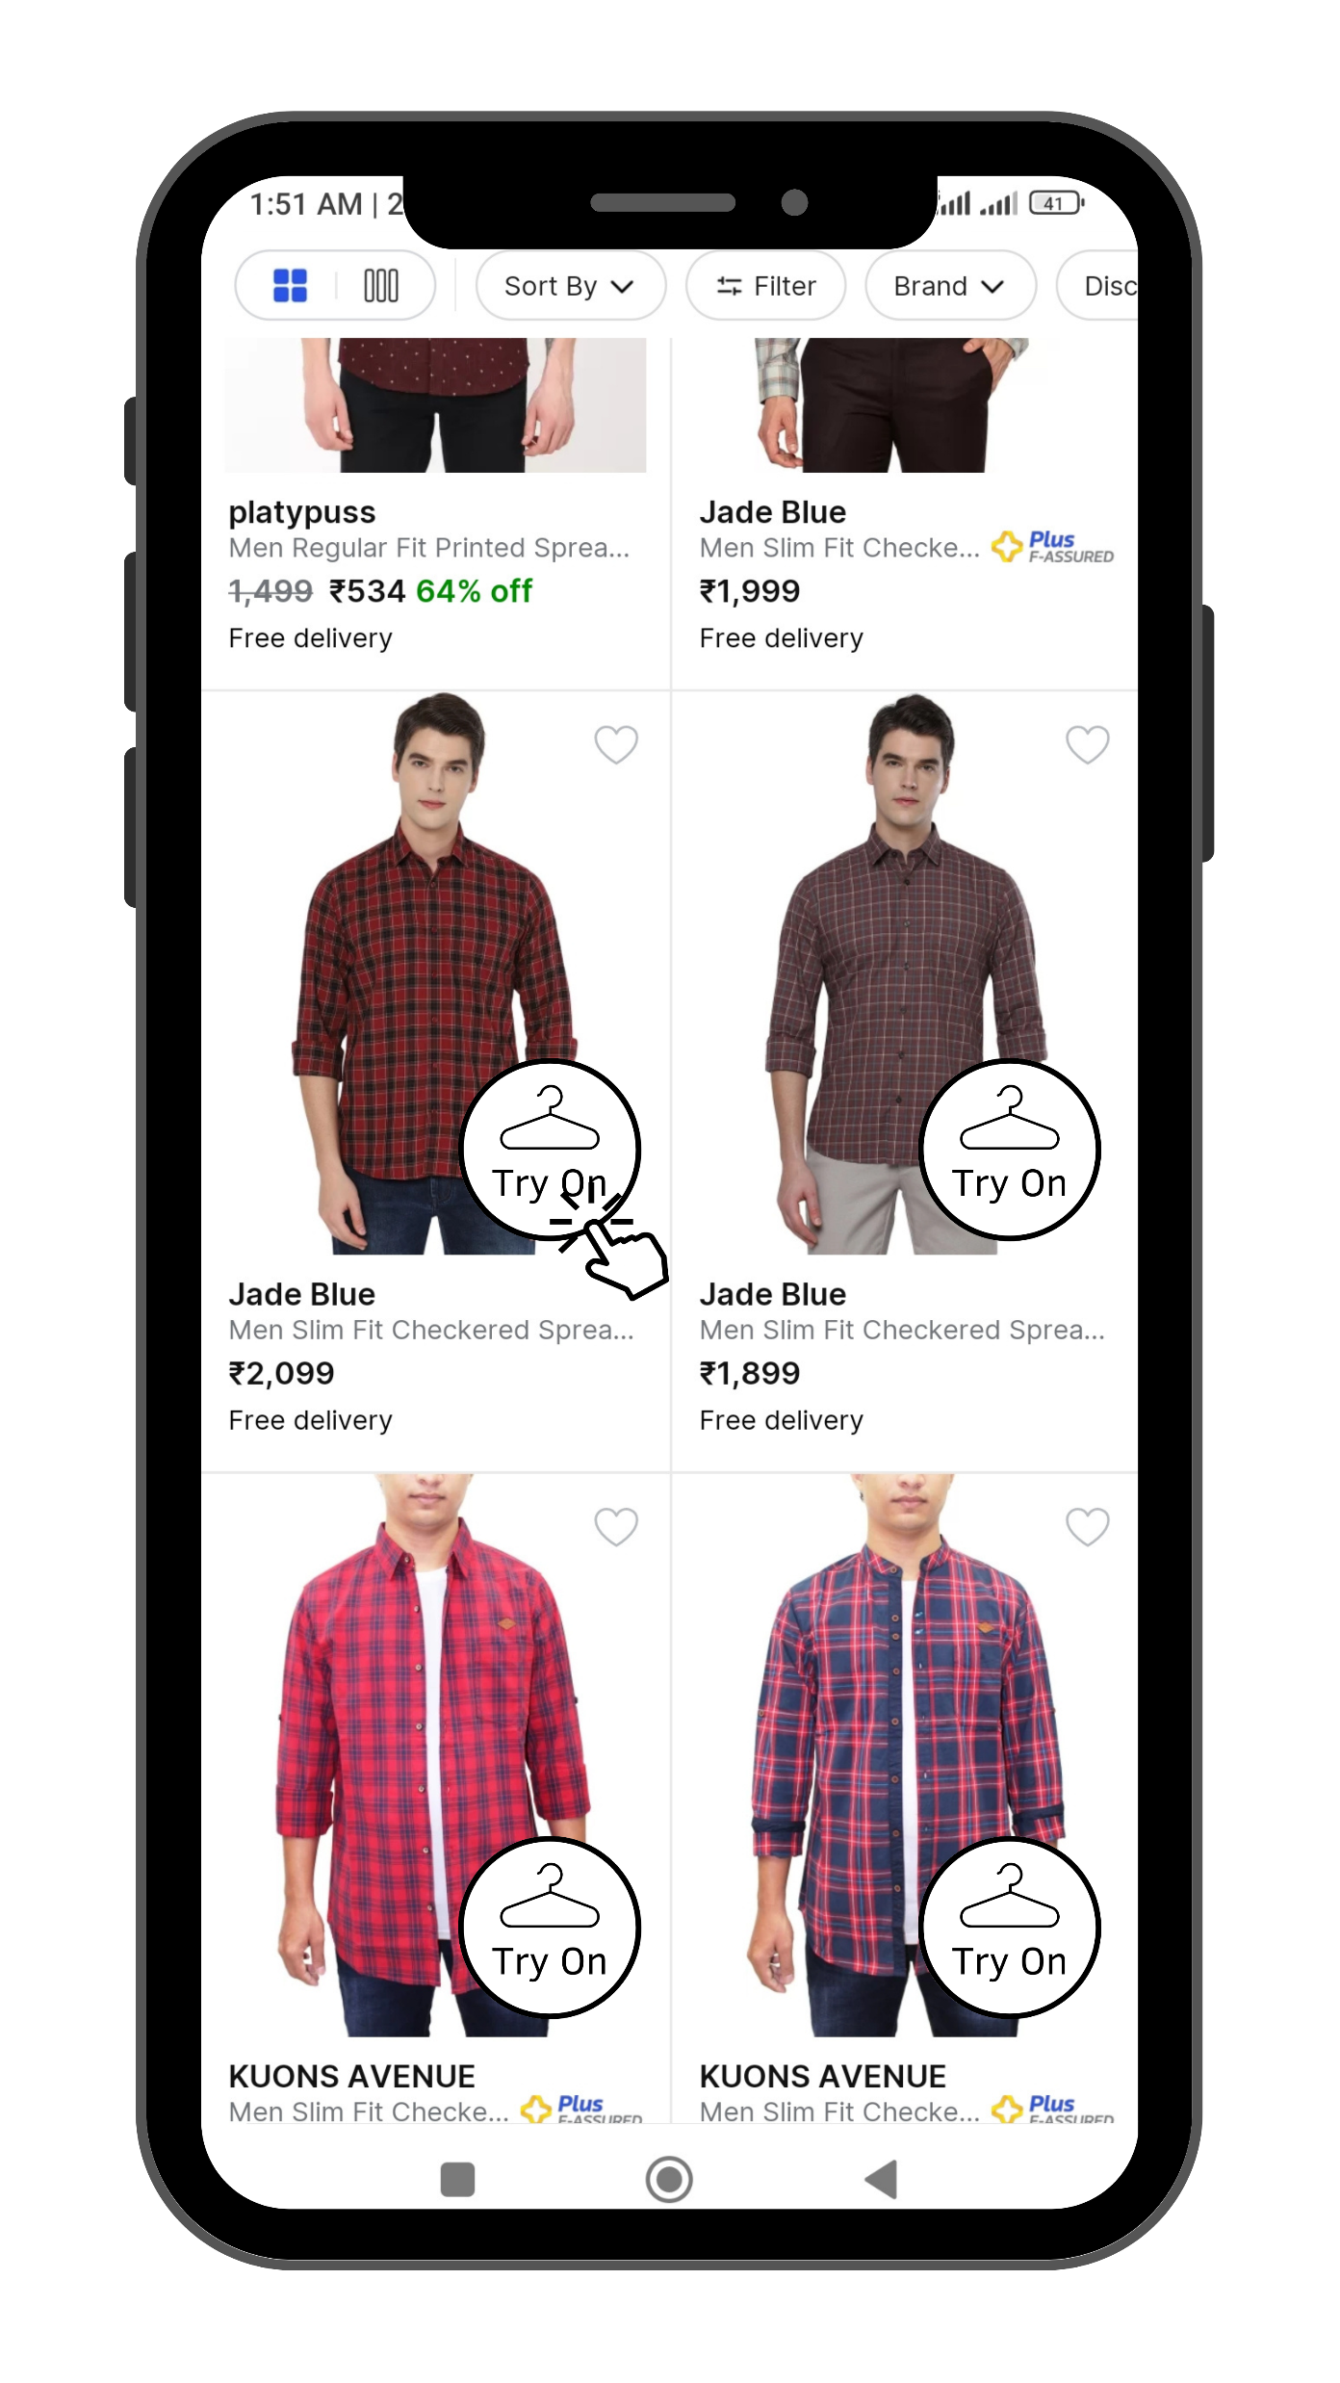
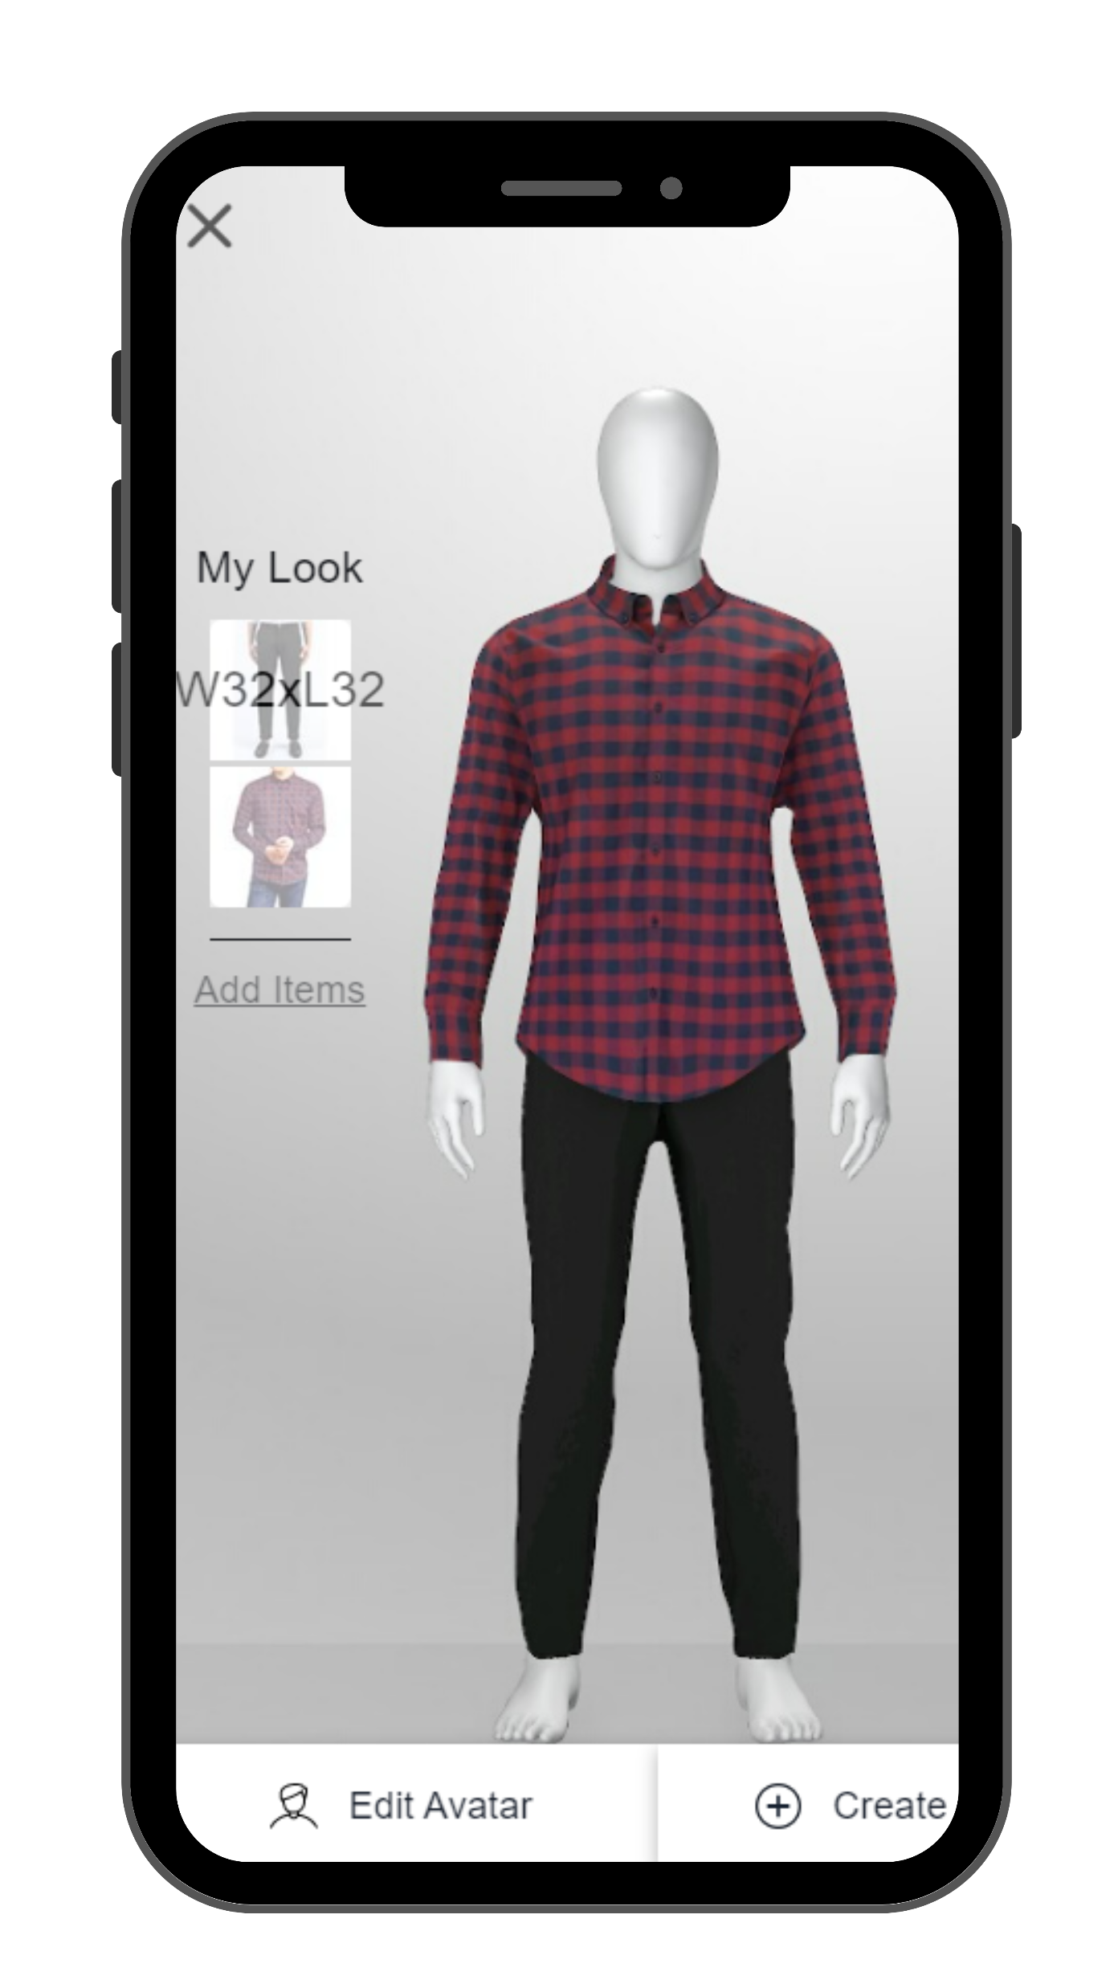
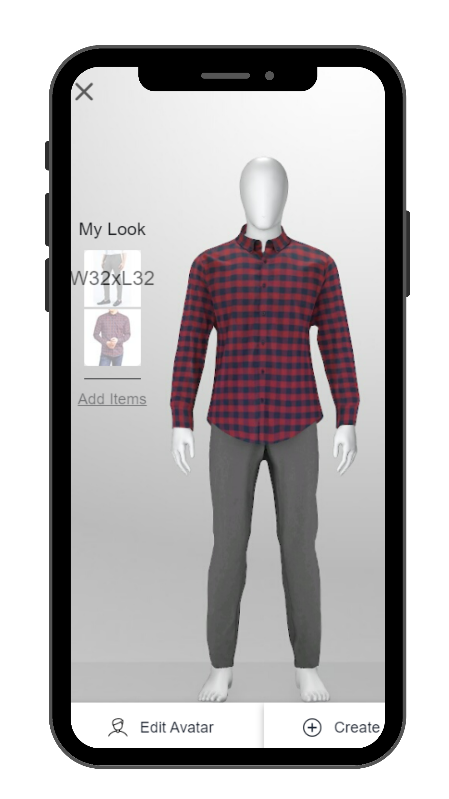
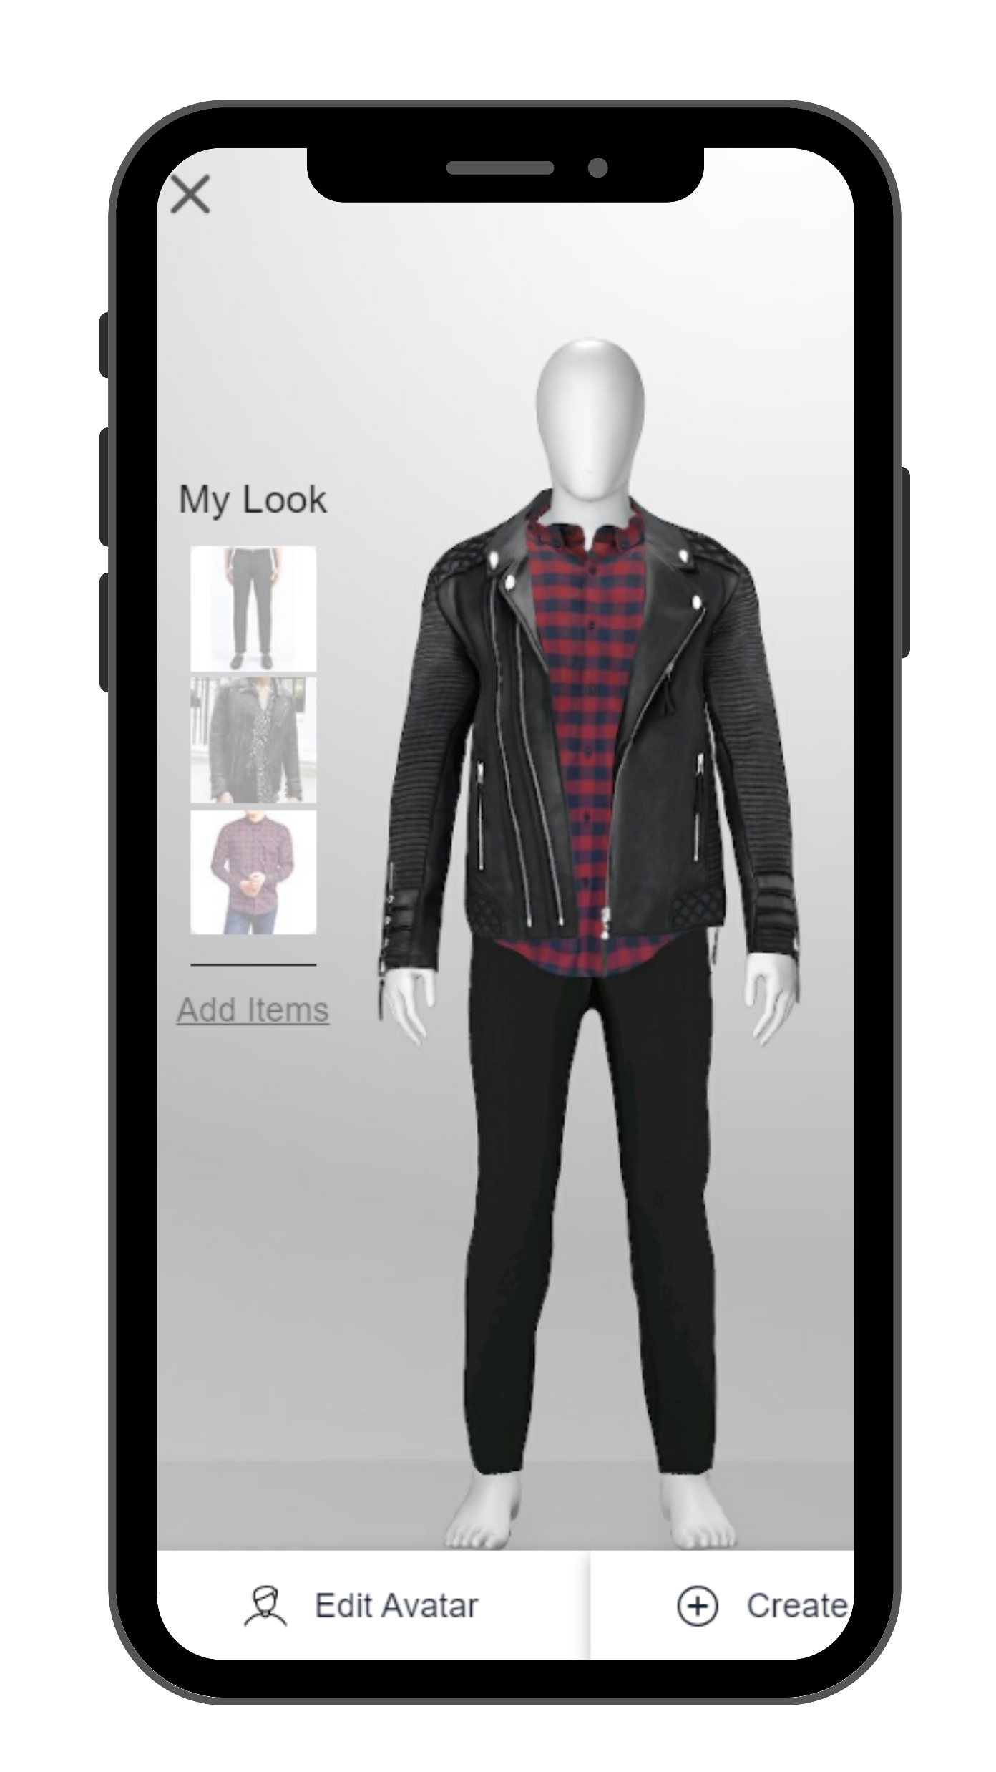
Idea #1: Digital Avatar enabled Virtual Trial Room | Objective: To increase the engagement of current user base on the App
User Pain Points
Why Apparels? (KPMG report)
Why Virtual Trial Room?
User unable to check how would they look in the selected apparel
User unable to match pairs of upper wear and bottom wear
Apparel is the top selling category in Tier 2 cities followed by Fashion and Electronics
Consumers in Tier-3 cities are 1.4X more inclined towards spending on Apparel than Tier-1 cities
Replicate offline experience of apparel trials
146 out of 180 of the TG voted “Yes” for the feature in our primary research
Cross-sell complementary item via matching
No competitor has tried this till date
Customer decision making journey and how this feature will increase engagement and user satisfaction
Matching Shirt and jeans
The create my avatar option will be on the home page for higher visibility and trialability of the new feature
Users will be given two options. Either to create their avatar through facial recognition or manually
Users can add detailing to their avatars (skin tone, hair colour, beard style etc) to check apparels on different looks
There will be a try on badge on the apparels. If a user wants to try a particular product they can simply click on that
Once user clicks on try on they will be redirected to the virtual trial room where they select their size through AI
User can select multiple upper and bottom wears to check multiple combinations and select the best one accordingly
User can select complimentary products like Jackets, Glasses, Shoes, Watches etc to have 360 degree experience

Slide 5




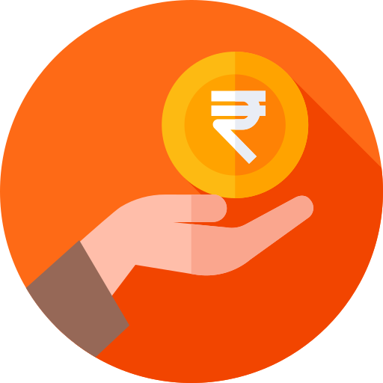









Idea #1: Execution Plan | UAT | Risk & Risk Mitigation | Requirements | Cost | Expected Benefit
Feature Development
Alpha Testing
User Acceptance Testing
A/B Testing
Buffer
Launch
Roadmap
2.5 Months (From Dec 2023)
1 Month
1 Month
4 Months
Big Billion Days 2024
Protype testing primary insights*
Feature Requirements
Possible Risks Involved
84 testers, Age 20-27, Forms + DI, Agra, Bikaner
Build the feature from scratch. Requirements: Metaverse developers, Digital artists & AI experts
Unsupportive UI structure, Impact on other features, App size may increase
68%
Found this feature useful for them
Options
Loss of acquisition amount if feature didn’t work, Unequal budget allocation
Collaborate or acquire similar service provider for end-to-end implementation.
Suggestion: Style.me
54%
Found this feature engaging for them
Low user adaptability, Limited usage risk
80%
Agreed, it will influence their shopping
Agreed, it will replicate offline buying
(Technology and content provider for digital fashion)
Risk Mitigation Plan
34%
Note: We suggest to acquire style.me because – 1) They have patent of the technology, 2) Metaverse is an upcoming boom, 3) It gives Competitive advantage
Extensive A/B testing using multiple use cases in the app using the FMEA model
68%
Found it easy to use and convenient
*Questionnaire
Pilot projects in selected cities and beta testing with users and experts
Scalability: Recent studies show how people are ready to overpay by almost 40% for a product that can be tested in 3D. Journey: Starting from Apparels -> To Footwear (NIKE) -> To Fashion (GUCCI) -> To Furniture (IKEA)….. (Inspiration: Flipkart launches Flipkart Labs to leverage metaverse, NFTs for business)
Extensive primary research through FGDs and In-depth interviews in TG cities
Future Proofing
Competitive Advantage
$10 million
351m
1st mover advantage, as no other direct competitor has tried this till date.
Cost
Style.me current valuation
Active internet users in Tier 2&3 growing @ 6%. IAMAI KANTAR report
5G launch to support advance technology. Expected full coverage by 2024
As per Gartner, 25% people will be spending at least 1 hr. /day on metaverse by 2026.
Replicating the offline experience of apparel shopping gives competitive advantage over brick and motor stores in the Tier 2 and 3 cities
Increase in user engagement and loyalty
^{Benefit}
Reduced Digital-Physical shopping gap
Up to 20% increase in time spent on App

Slide 6


Idea #2: Pooled buying | Objective: To increase acquisition of customer in Tier 2 cities who have not explored Ecommerce
Why Pooled Buying?
The Pooled Buying Model
To acquire new customers, with the value proposition of incremental discounts on pooling the purchases together
B gets x% discount on his first order
For every addition in buying circle, extra discount ‘y’ %
A onboards B through group formation
A & B form a buying circle for availing offers
If A, B pool with another buyer C, discount increases
Social aspect of purchase
Trust reinforced
A gets redeemable credits on onboarding
User Journey
Opens App
Products shipped for all the members of the group. Purchase complete
Click on the GroupBuy button on Homepage
Click on add friend, generate unique shareable invite
Invite shared with friends or family. Two or more people join in
Discount unlocked for all three or more
Users browse through products
Users discuss about the products in an in-app chatroom
User selects a product to buy, and makes payment
Others make a purchase in time
Refund to ones who already paid and order is cancelled
Benefits to Flipkart
Benefits to end customer
Access to a wider customer base
Ease of order aggregation
Ability to offer lower prices
Lower prices by pooling
Better product suggestions
Better prospects by scaling
People will onboard more people for reward points and incremental pooling discounts
Easier to aggregate orders in same/adjacent pin codes resulting in faster delivery
Efficient order aggregation resulting in lower cost of serving, consequently lower prices
Lower costs of serving by aggregation will lead to lower prices in the form of extra discounts
Offline subcontracting of purchase decision replicated in online mode fuelled by discounts
The model shall be increasing the discounts as more people in the vicinity sign up for pooling
Notes:
Building the model:
Log(likelihood that the order will be placed) = f( Buying circle size, discount offered)
Assumptions: Buying circle size is considered to be a skewed normal distribution with mean between 4-5
Discounts offered are following an exponential distribution, directly in relation to the buying circle size
Assumption:
The buying circle size is skewed normal distribution
The discounts offered is directly proportional to buying circle size

Slide 7
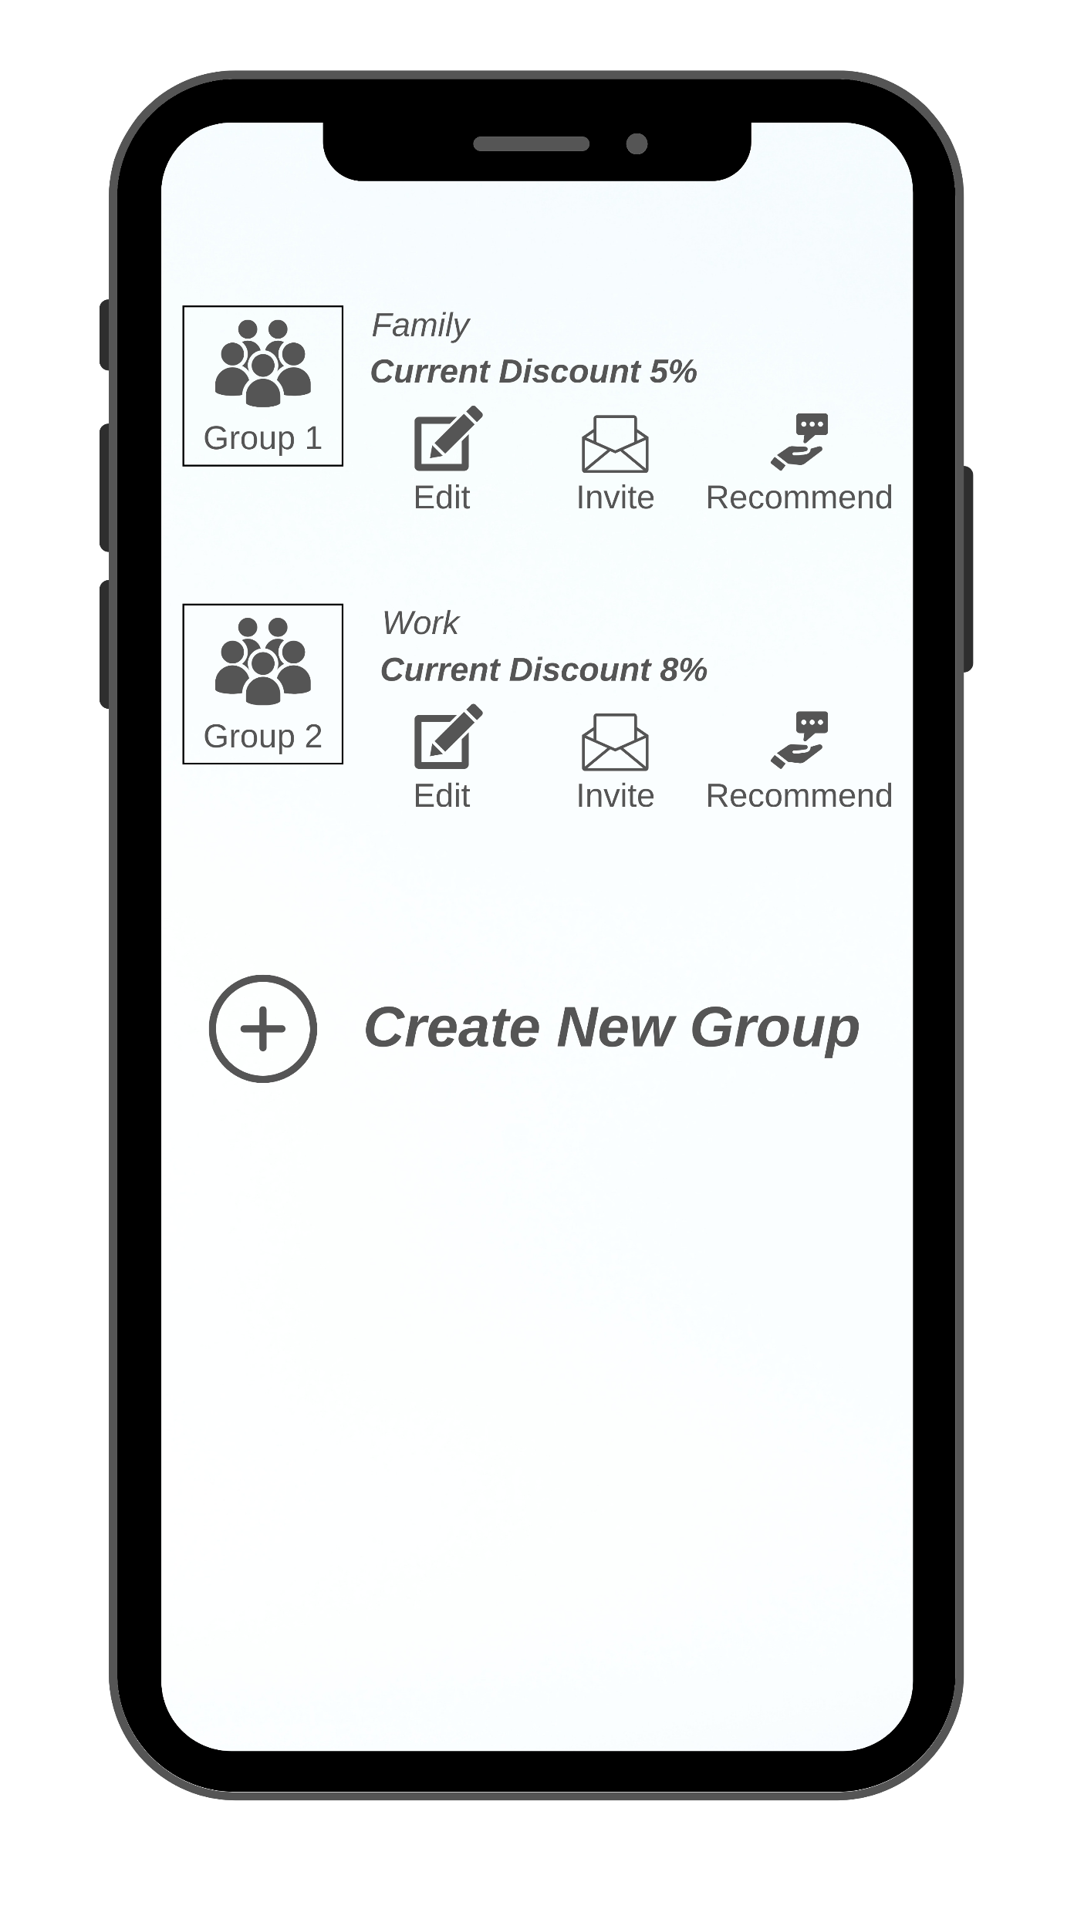













Idea #2: Execution Plan | Modelling | Risk & Risk Mitigation | Scalability | Cost | Expected Benefit
Feature Development
Alpha Testing
User Acceptance Testing
A/B Testing
Buffer
Launch
Roadmap
1.5 Months
1 Month
1 Month
4 Months
Big Billion Days 2023
Buying groups for pooled buying
Possible Risks Involved
In a buying group, the discount depends on the number of members in the group. In order to increase discounts for the entire group, the user can add a new member. Moreover, additional discount is received if the user recommends a product to a member who ends up buying it. Once the members join in, the discount is unlocked for a specified period, 24 hours(to be tested)
Possibility of a low conversion rate, on introduction of the feature
Possibility of one of the users from a particular group may return the Product
Building the prediction model
Inappropriate pricing may lead to a loss on the sale(discount>margin)
The factors influencing the order placement are: buying circle size, discount offered and time specified
Users may resort to creating fake accounts to gain discounts
Likelihood that the order is placed
F(buying circle size, discount offered, time)
Fluctuations in inventory levels as products are blocked when users make a purchase but released when the order is canceled due to the group purchase not being successful
Training Data
Assumptions:
The buying circle size is skewed normal distribution
The discounts offered is directly proportional to buying circle size
Risk Mitigation Plan
Price Optimization using ML Algorithms
Supervised Machine Learning Algorithm
Creation of verified accounts using one unique ID (Aadhaar)
Show quantity left, notification to group when product again in stock
New Data
Classifier
Prediction
This model can be supported with superfast delivery stores. Pooling supplies can help form a cluster. This model works best when members stay nearby. This would work well in multiple demand and supply hotspots in cities.
Development cost
(2-3 L/month) Reference
Cost
Testing & Marketing expenses (1% of marketing budget)
Scalability score* (Appendix)
Future Proofing:
Competitive advantage:
:
4.2%
Quicker and cheaper onboarding of new users
Increase in user engagement
Annual growth rate of active social media users(networking)
Cost
Low CAC, due to networking effect
Higher penetration to non-users
^{Benefit}
Increase in GMV, due to increase in purchases
Notes:
Possibility of a low conversion rate once the user activates the feature.
The possibility of one of the users from a particular group may return the Product.
Discounts on some of the products may lead to a loss on the sale(discount>margin) if pricing not appropriately done. – using ML algorithms for price optimization
Some users may resort to creating fake accounts to gain discounts. – verified accounts
May lead to fluctuations in inventory levels as products are blocked when users make a purchase but released when the order is canceled due to the group purchase not being successful.
One of the risks & edge cases would be when one of the customers is buying a high-priced item while the others buy low priced items. This edge case can be misused.

Slide 8














Idea #3: Indirect Onboarding of Users | Driver: Shopsy | Reseller activation: Acquisition | Different reseller profiles
Who’s the buyer ?
Indirect Onboarding
What’s the idea?
Smitha (34): Security Guard at TAPMI
Lives in Udupi. 10th pass, has smartphone
Indirect Onboarding through
Reseller Acquisition through employment programs
Buys apparels & other from local stores in cash
Never used Ecommerce, no intentions in future
Trust issues, Complicated apps, price sensitive
Use WhatsApp, part of groups & communities
For: People use internet but not ecommerce
For: Who trust friends and families to buy from
Through: local trustworthy retailers on Shopsy
Through: Maintaining the buyer status quo
Reseller Education & Readiness Program through Shopsy Academy
Reseller Engagement through Shopsy Community feature
Benchmark: Meesho | Improvisation: The “Tupperware” model | Market: $7 Billion by 2025 | Hence, creating a holistic resellers ecosystem is the key to penetrate this market
Reseller Acquisition
Target Resellers
Acquisition Techniques
12th / College pass-out girls
- Basic smartphone knowledge
- Not allowed to take an office job
- Good understanding of Apparels, Cosmetics and Fashion products (most sold category in Tier 2,3 & 3+)
School and College events where Flipkart can take workshops and promote women entrepreneurship by spreading awareness about the smart work from home earning way by using cell phone & internet
Targeted Advertisement on Social Media platforms like Facebook and Instagram
Housewives looking for part-time gig
- 9 million women entrepreneurs on Meesho saw 2.5X Y-O-Y growth
- Active women communities/WhatsApp groups
- Has holistic knowledge of the localities and its preferences for all category of users
Shopsy Wonder Women could be introduced. The resellers would be given referral bonus once they onboard another reseller on the app and they can build their own community of resellers
Women Self Help Groups in different cities and towns could be created with Flipkart representatives who will help and teach these women to use Shopsy and resale
Local Retailers
- Local trusted retailers are #1 trust markers when it comes to shopping (primary research)
- Retailers in tier 3 & 3+ town lack variety and quality products that Shopsy could provide them
- Retailers have high footfall during festivals
Stock on credit support to the retailers so that they can keep a minimum inventory of all the frequently purchased and in-demand accessories
Discounts on Mass orders during festive seasons and could be used as pickup and drop hubs

Slide 9

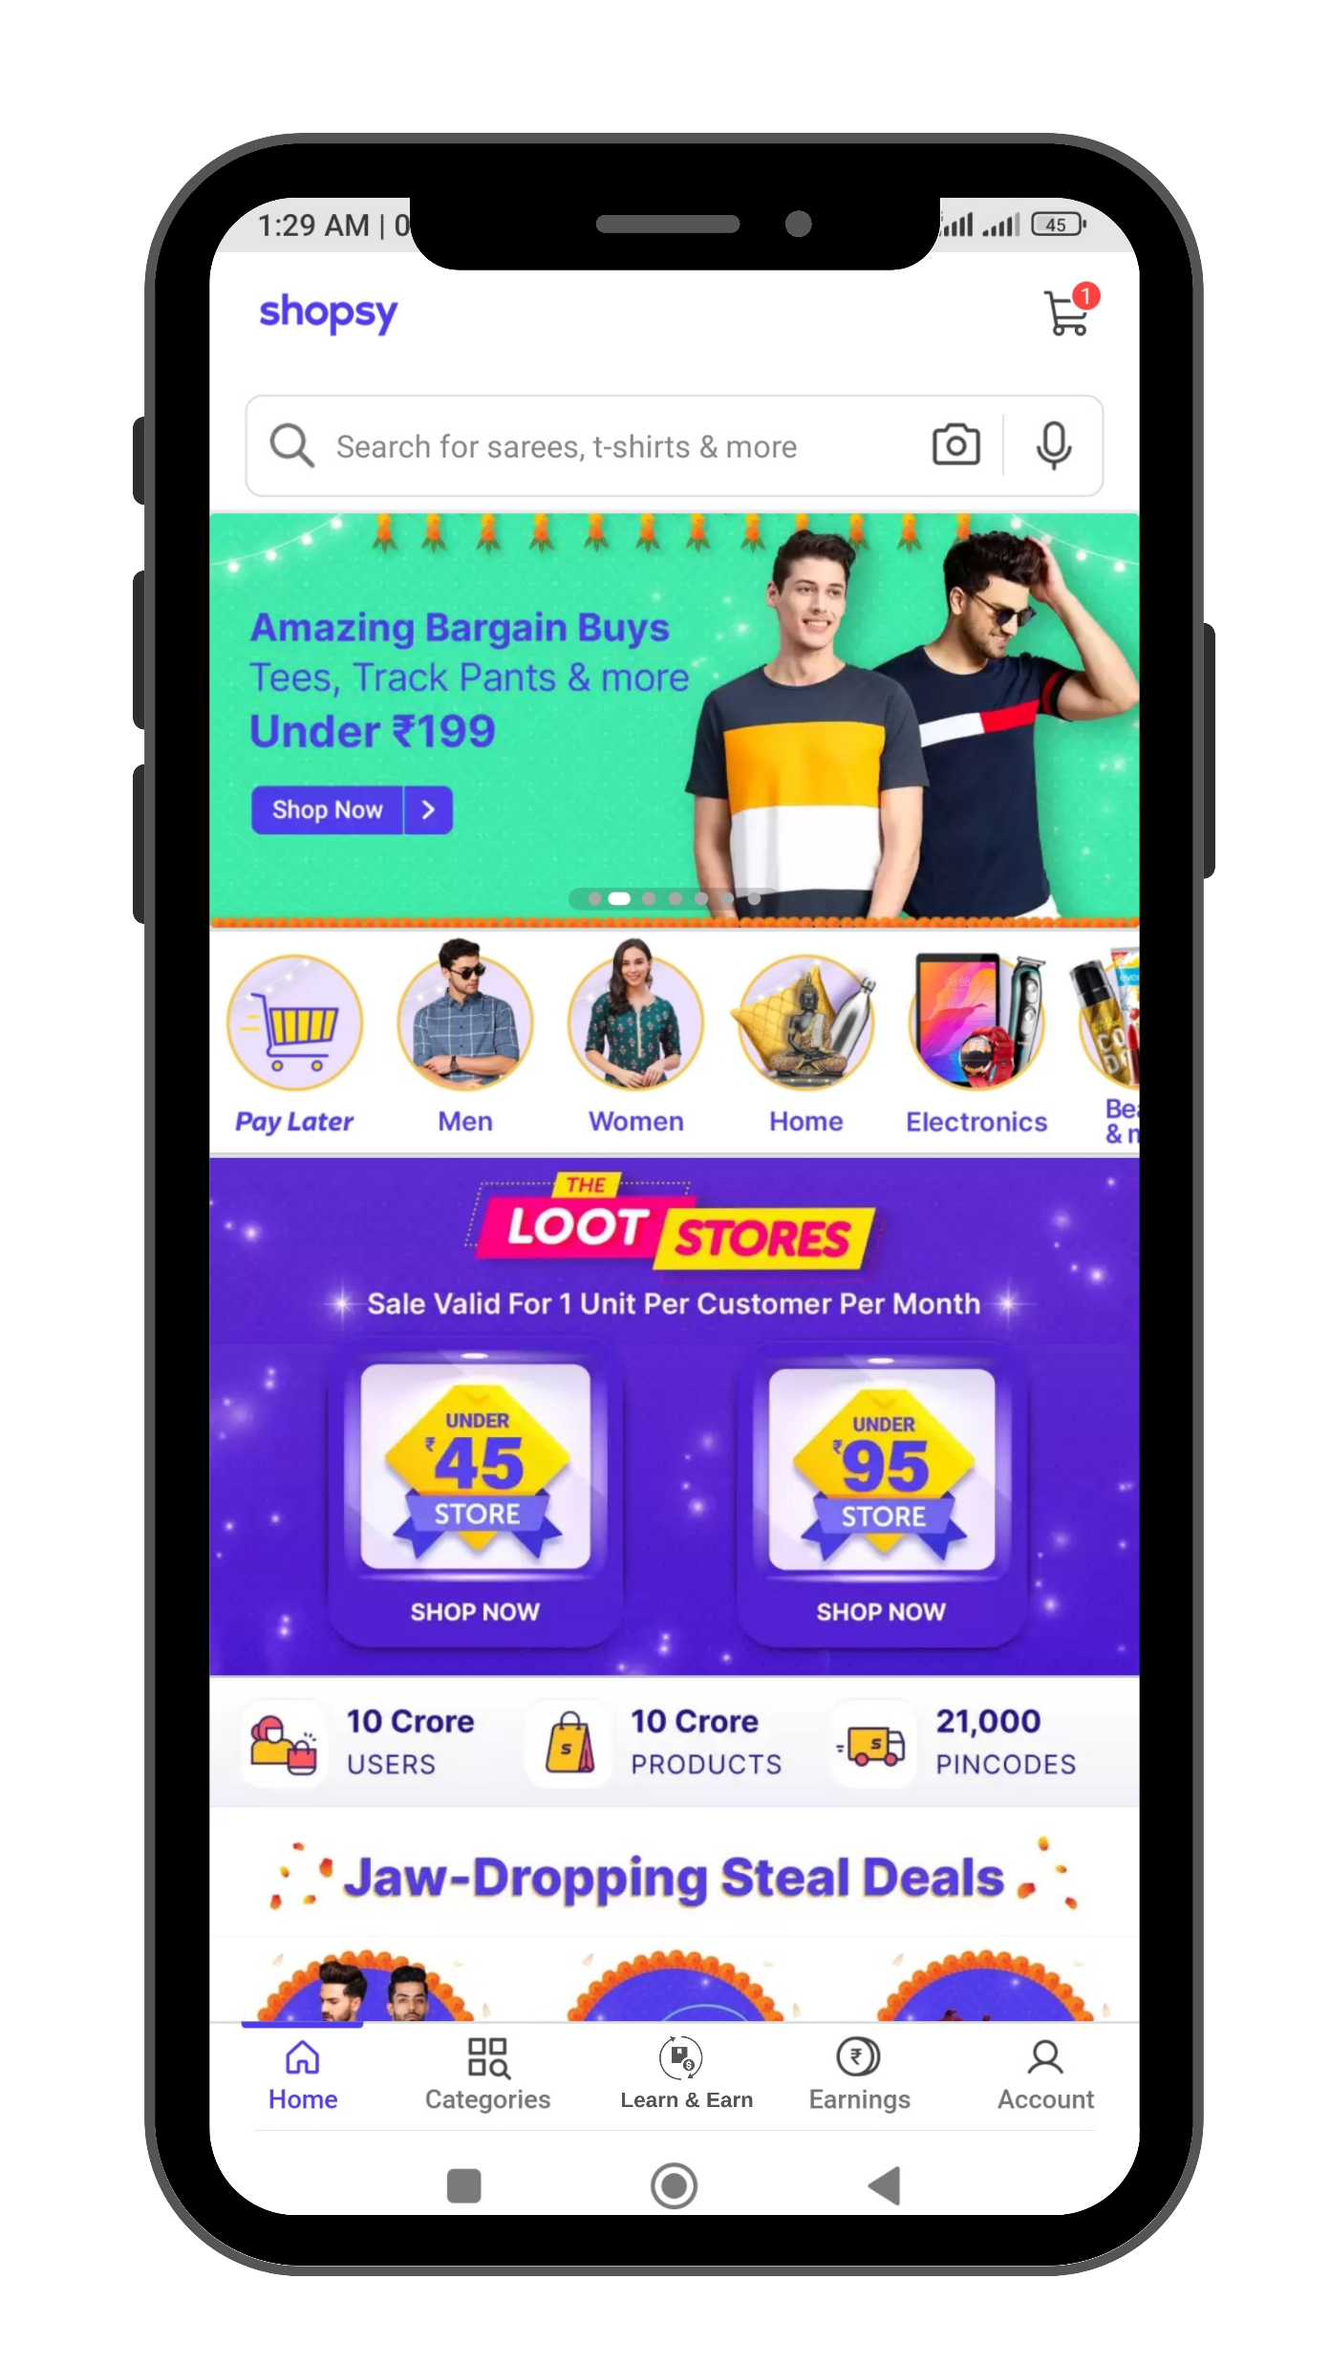
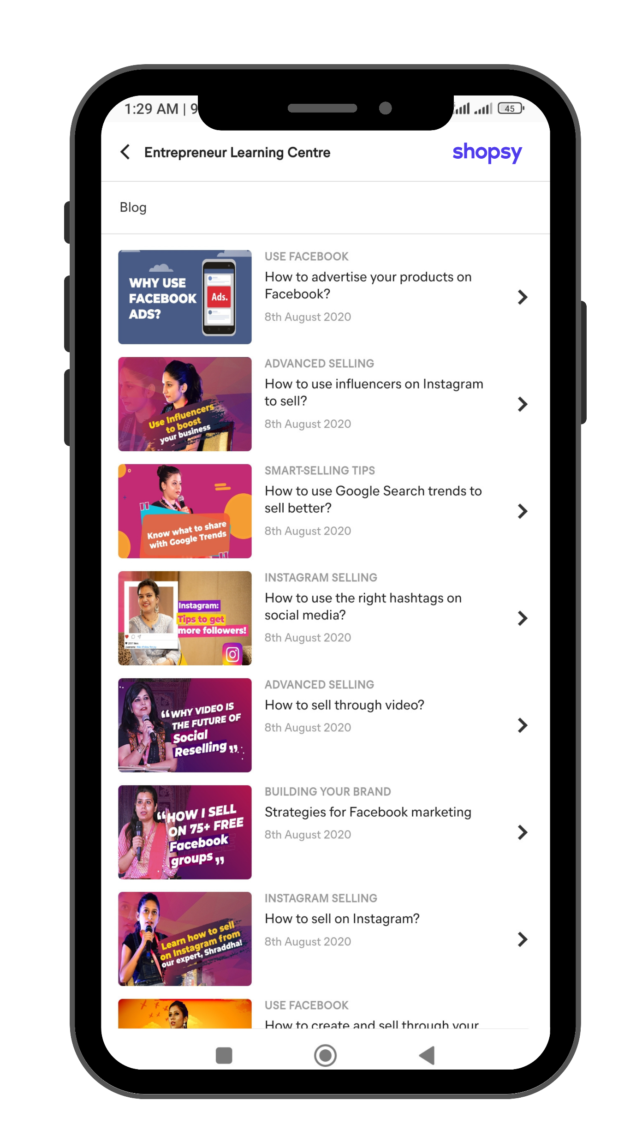

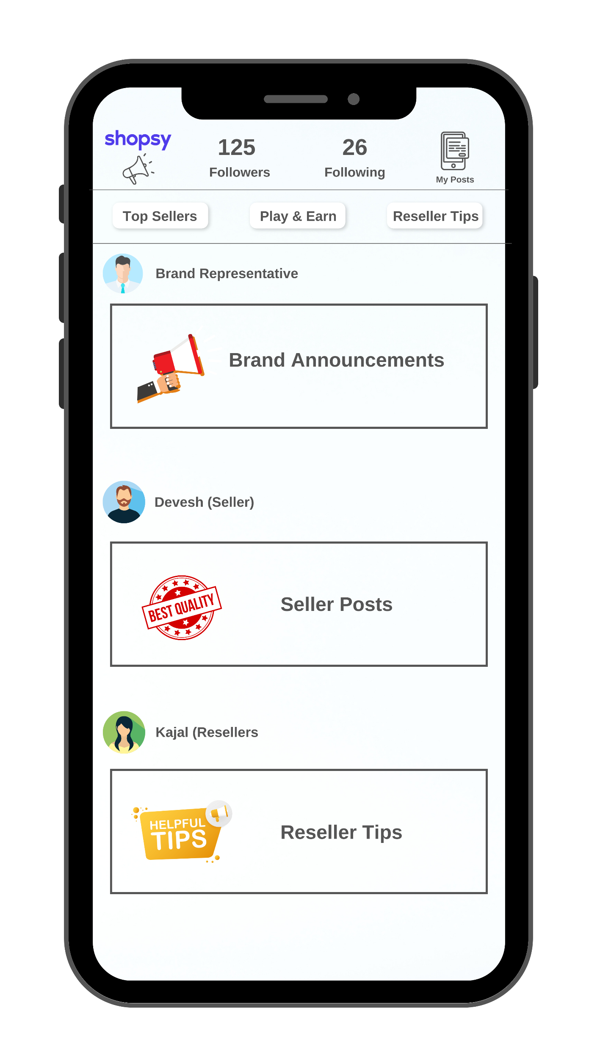
Idea #3: Indirect Onboarding of Users | Driver: Shopsy | Education – Shopsy Academy | Engagement – Shopsy Community
Reseller Education & Readiness Program
Well trained resellers tend to generate more revenue from the indirect buyers
Attracts more resellers to join the platform & spend more time there
Reseller onboarded on the Shopsy platform
Does not know much about reselling process
Benefits to Flipkart
Gets Reselling 101 guide as a go-to starter video
Becomes Certified Reseller
Gets the badge of Shopsy Certified Reseller, a motivation to earn more
Tips and tricks of Shopsy expert resellers provides technical help
Benefits to Resellers
Gets expert “How to” videos on efficiently using different channels
Started WhatsApp group/Social media page but not getting orders
Reseller Engagement: Shopsy Community
Reseller Profile: Reseller can post help, tips, feedback, Videos. They can follow their favourite sellers as well as fellow resellers
Seller and Resellers engagement will help to take market insights
Easy communication with every stakeholder involved
Benefits to Flipkart
Tags for brand announcements, Reseller Tips Video & Top Seller posts
Shopsy Community Feed:
- Interactive feed with daily updates by the brand representative account
- Brand can conduct daily quizzes and fun engagement to attract traction
- Sellers can post their product photos, promotions and short videos
- Resellers can interact with sellers through comment & DM feature
- Resellers can also interact with other resellers and form their own groups on the community feature for pooled buying and more discounts
Sellers can now directly interact with resellers to sell more
Resellers get more varieties and special discounts. They can also learn from fellow resellers
Benefits to Sellers & Resellers

Slide 10




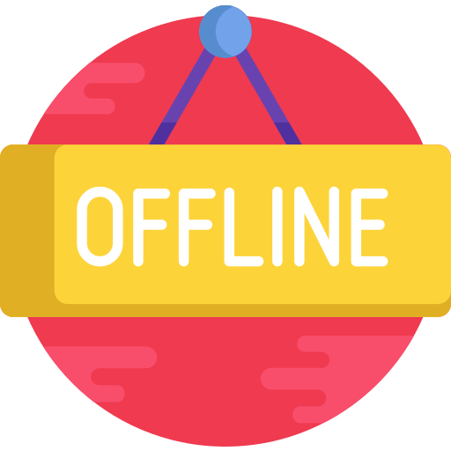
Idea #3: Execution Plan | Timeline | Future proofing | Risk & risk mitigation | Scalability | Cost-Benefit analysis
Feature Development
Alpha Testing
User Acceptance Testing
A/B Testing
Buffer
Launch
Roadmap
6 Months (Academy + Community)
3 Months
2 Months
4 Months
June 2024
User Journey: Indirect Onboarding
Feature Requirements
Possible Risks Involved
Smitha’s daughter urges to wear modern dress on Diwali
Modern dresses are not available in Udupi fashion & retail stores
Chatbots with adaptability of vernacular languages
Too much load on the app can cause app crash / lag / increased app size
Financial risks in providing the BNPL access to Verified resellers / big retailers
Smitha who trust her friend finds the dress her daughter wanted on her Catalog and placed order to Vineetha
Smitha’s friend Vineetha who is just became a Shopsy reseller shares modern dresses Catalog with her on WhatsApp group
On ground business development teams to find out & acquire resellers and customers on the platform
Sellers and resellers might not engage as expected
Content ideation, planning and execution. A lot of data on the requirement of different content needs
Risk Mitigation Plan
Vineetha has now followed the seller on Meesho community and interacts with everyone on the community to sell more
Vineetha started her Instagram page with the help of Shopsy Academy and now sell 3X more to the unknown audience on Insta
One feature at a time with A/B testing and size compatibility using FMEA model
Proper KYC of the resellers and retailers
Scalability: Social commerce through short videos. (Flipkart, Moj tie up to take video, live commerce to next 200 MN customers). GMV of live commerce through short videos would touch $5 billion in India by 2025. In another recent study by Bain & Company, three in four Internet users (or 600 to 650 million Indians) will consume short-form videos by 2025.
Extensive primary research through FGDs and In-depth interviews in TG cities
Future Proofing
80%
Competitive Advantage
Shopsy Academy: 7.75 lacs per month. Calculation mentioned in Appendix
62.4%
The suggested community feature is the improvised version of Meesho’s
Cost
Shopsy Community: 6.5 lacs per month. Calculation mentioned in Appendix
Growth in UPI payments expected in Tier 2,3&3+ towns in the coming years according to a PWC report
.
Is the expected CAGR of the social commerce market in India 2022-2028, according to a report by prnewswire
As of now no other competitor is doing offline penetration with local events
Expected 3x growth in the revenue from Tier 2,3 & 3+ cities through online + offline penetration Benchmark: Pinduoduo (Ycombinator report)
^{Benefit}

Slide 11
Appendix – Click Here

